Slide 1
MACHINE LEARNING
Asist.Prof.Dr. Murat ŞİMŞEK

Slide 2
Learning
Learning is a computational process for improving performance based on experience.

Slide 3
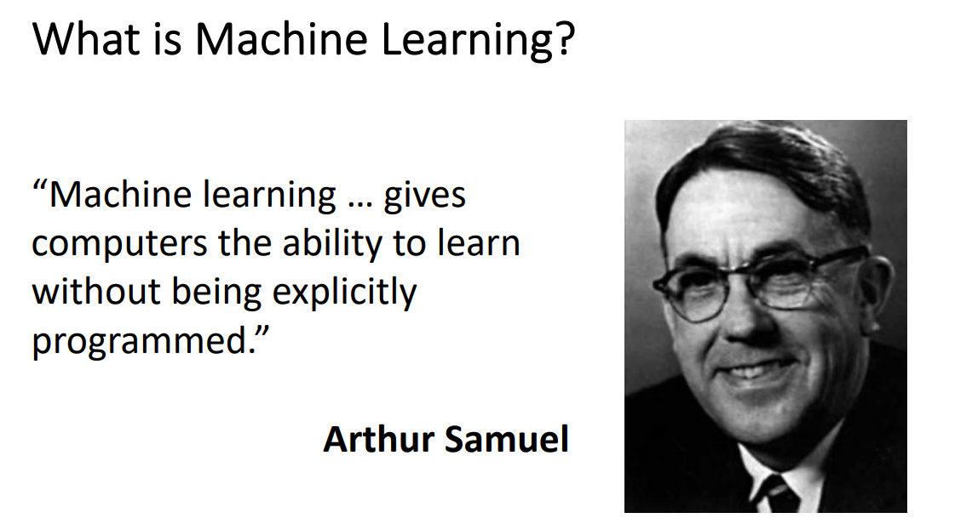
Machine Learning

Slide 4
Machine Learning
Machine learning (ML) is a field of inquiry devoted to understanding and building methods that 'learn', that is, methods that leverage data to improve performance on some set of tasks.

Slide 5
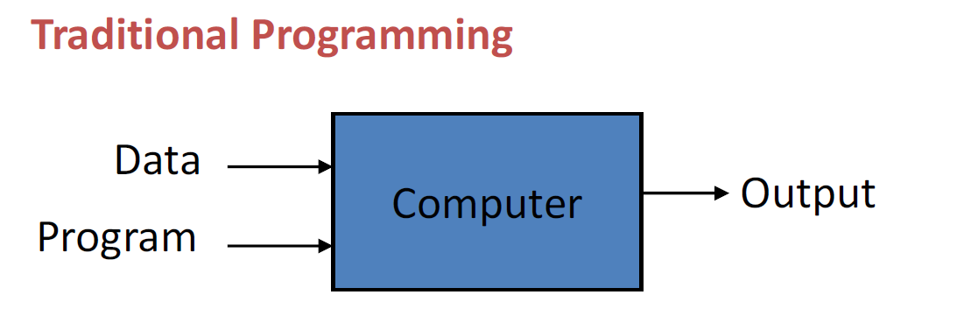
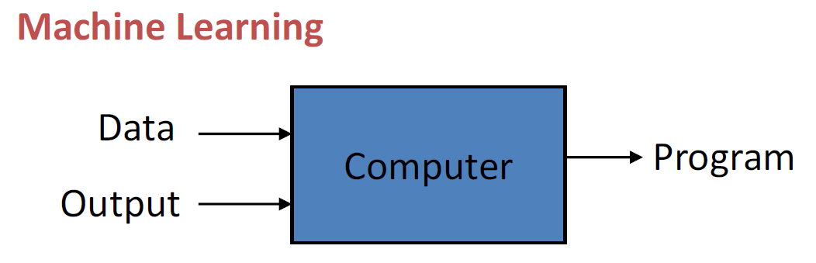
Machine Learning
Karan Kathpalia

Slide 6
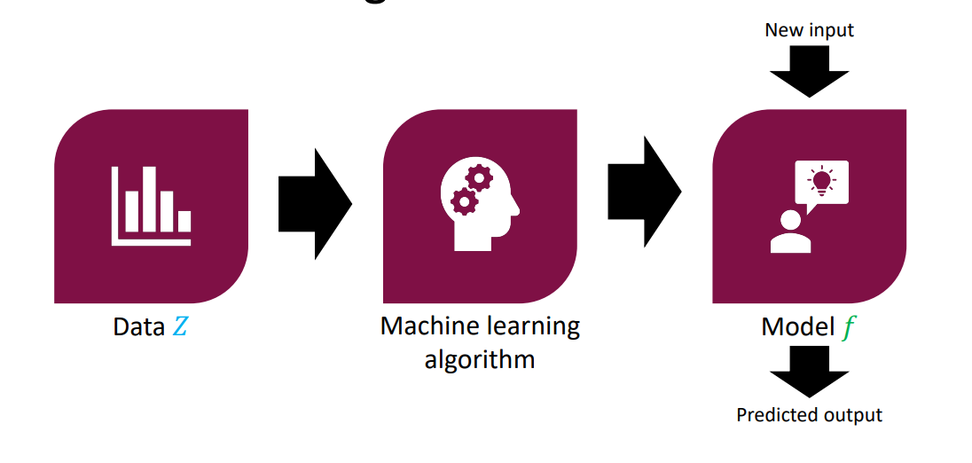
Machine Learning
Karan Kathpalia

Slide 7
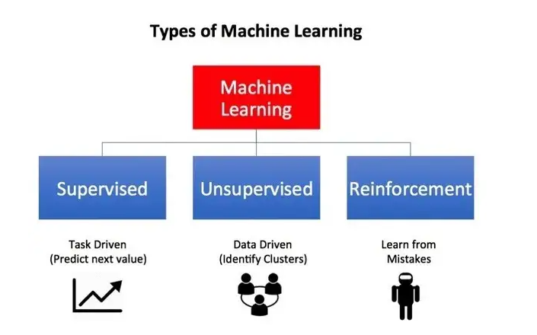
Machine Learning
Karan Kathpalia

Slide 8
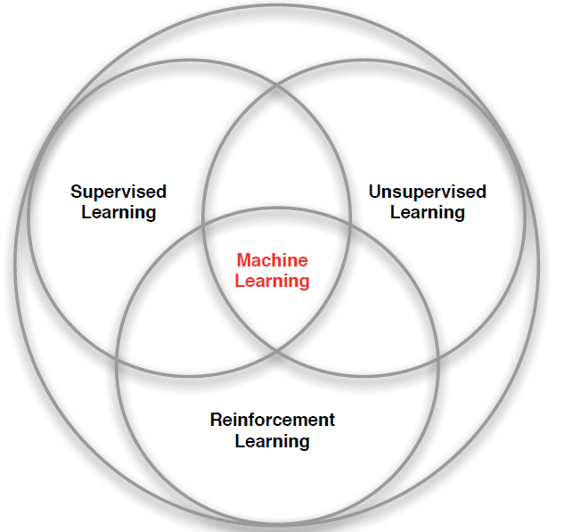
Machine Learning
Karan Kathpalia

Slide 9
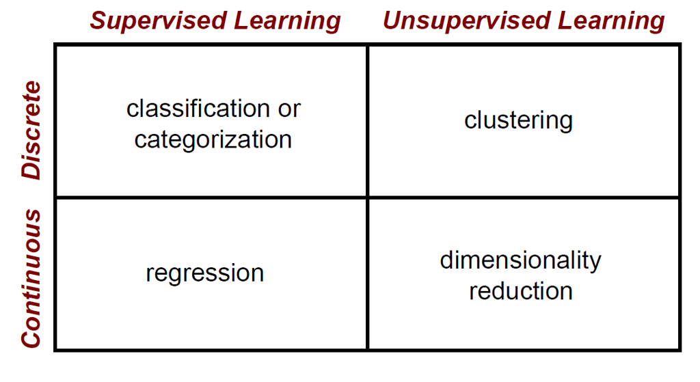
Machine Learning Problems

Slide 10
Machine Learning Areas
Supervised Learning: Data and corresponding labels are given
Unsupervised Learning: Only data is given, no labels provided
Semi-supervised Learning: Some (if not all) labels are present
Reinforcement Learning: An agent interacting with the world makes observations, takes actions, and is rewarded or punished; it should learn to choose actions in such a way as to obtain a lot of reward

Slide 11
Machine Learning
Supervised Learning: learn a model from the data using labeled data.
Classification and Regression are the prototypical examples of supervised learning tasks. Other are possible (e.g., ranking)
Unsupervised Learning: learn a model – extract structure from unlabeled data.
Clustering and Association Rules are prototypical examples of unsupervised learning tasks.
Semi-supervised Learning: learn a model for the data using both labeled and unlabeled data.

Slide 12
Supervised Learning
Karan Kathpalia

Slide 13
Supervised Learning : Important Concepts
Data: labeled instances <X, y>,
Training Set
Test Set
Features: attribute-value pairs which characterize each X
Experimentation cycle
Learn parameters (e.g. model probabilities) on training set
(Tune hyper-parameters on held-out set)
Compute accuracy of test set
Evaluation
Accuracy: fraction of instances predicted correctly

Slide 14
Supervised Learning
Learning a discrete function: Classification
Boolean classification:
Each example is classified as true(positive) or false(negative).
Learning a continuous function: Regression

Slide 15
Supervised Learning (Regression)
Regression analysis is used to:
Predict the value of a dependent variable based on the value of at least one independent variable
Explain the impact of changes in an independent variable on the dependent variable
Dependent variable: the variable we wish to predict or explain
Independent variable: the variable used to predict or explain the dependent variable.

Slide 16
Supervised Learning (Regression)
House price prediction
Price ($)
in 1000’s
Size in feet²
Supervised Learning
“right answers” given
Regression: Predict continuous valued output (price)

Slide 17
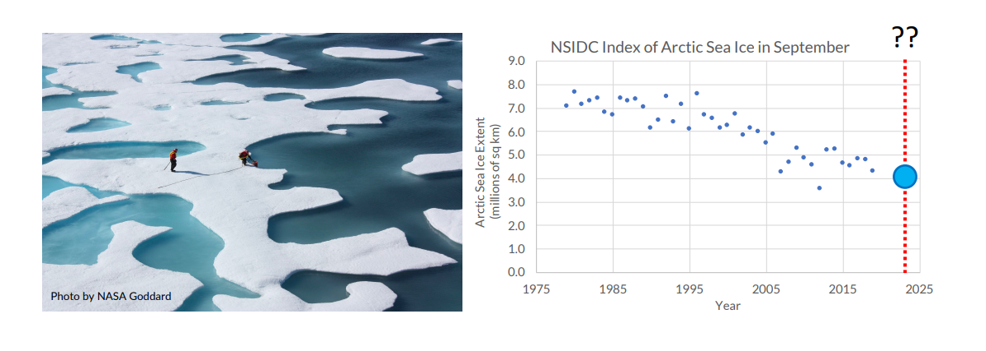
Supervised Learning (Regression)

Slide 18
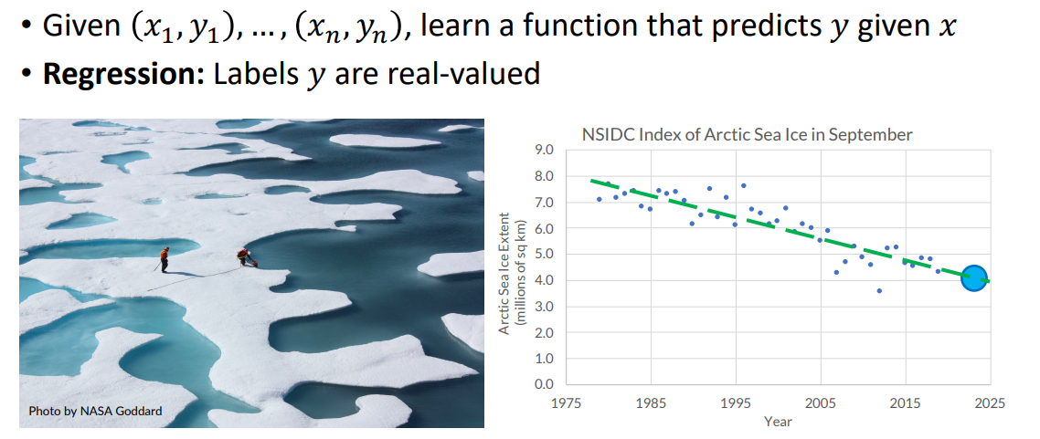
Supervised Learning (Regression)

Slide 19
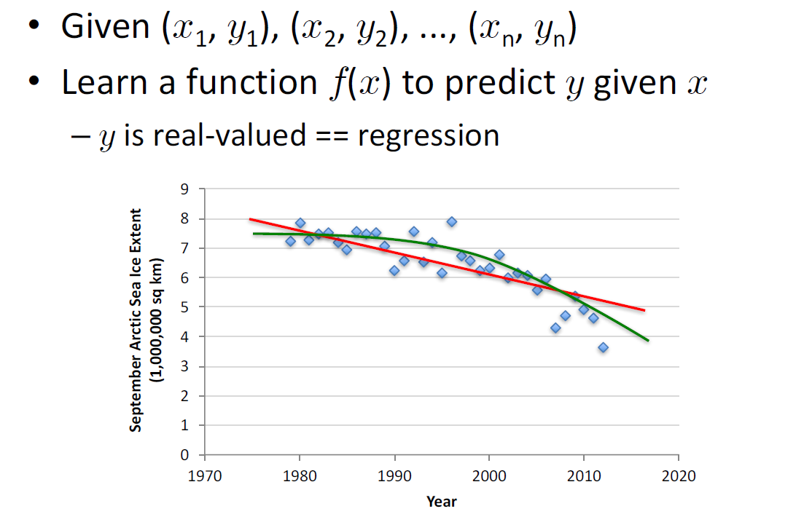
Supervised Learning (Regression)

Slide 20
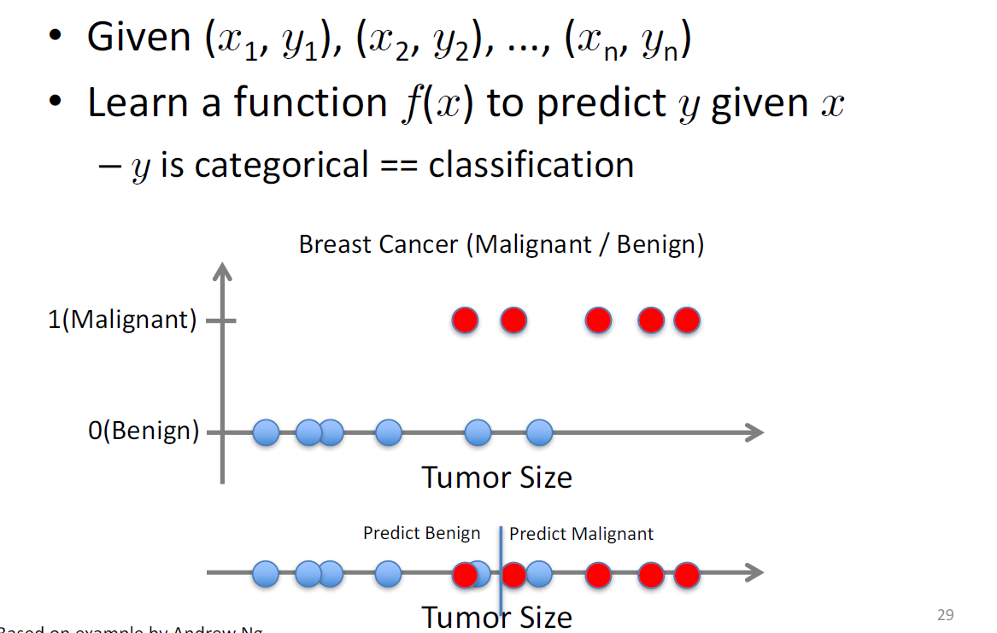
Supervised Learning (Classification)

Slide 21
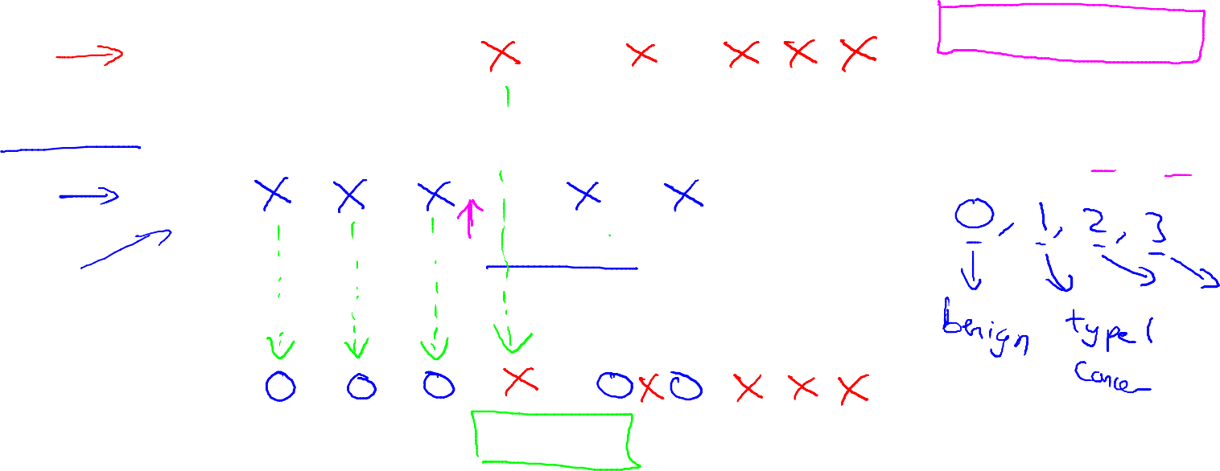
Harmful
Not Harmful
Breast cancer (malignant, benign)
Classification
Discrete valued output (0 or 1)
1(Y)
Malignant?
0(N)
Tumor Size
[Feature 1]
Another way of representing above graph
Tumor Size

Slide 22
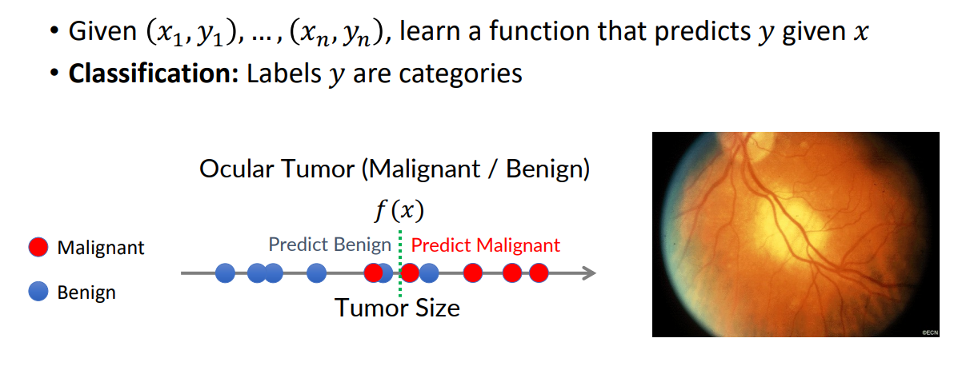
Supervised Learning (Classification)

Slide 23
Example
You’re running a company, and you want to develop learning algorithms to address each of two problems.
Problem 1: You have a large inventory of identical items. You want to predict how many of these items will sell over the next 3 months.
Problem 2: You’d like software to examine individual customer accounts, and for each account decide if it has been hacked/compromised.
Should you treat these as classification or as regression problems?
Treat both as classification problems.
Treat problem 1 as a classification problem, problem 2 as a regression problem.
Treat problem 1 as a regression problem, problem 2 as a classification problem.
Treat both as regression problems.

Slide 24
Supervised Learning Steps
Model the problem
What is you are trying to predict? What kind of optimization function do you need? Do you need classes or probabilities?
Extract Features
How do you find the right features that help to discriminate between the classes?
Obtain training data
Obtain a collection of labeled data. Make sure it is large enough, accurate and representative. Ensure that classes are well represented.
Decide on the technique
What is the right technique for your problem?
Apply in practice
Can the model be trained for very large data? How do you test how you do in practice? How do you improve?

Slide 25
Supervised learning
To learn an unknown target function f
Input: a training set of labeled examples (x_{j},y_{j}) where y_{j} = f(x_{j})
E.g., x_{j} is an image, f(x_{j}) is the label “giraffe”
E.g., x_{j} is a seismic signal, f(x_{j}) is the label “explosion”
Output: hypothesis h that is “close” to f, i.e., predicts well on unseen examples (“test set”)
Many possible hypothesis families for h
Linear models, logistic regression, neural networks, decision trees, k-nearest-neighbor etc

Slide 26
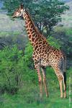
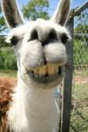
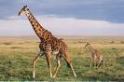
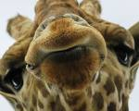
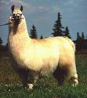
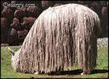
Example: object recognition
x
f(x)
giraffe
giraffe
giraffe
llama
llama
llama

Slide 27
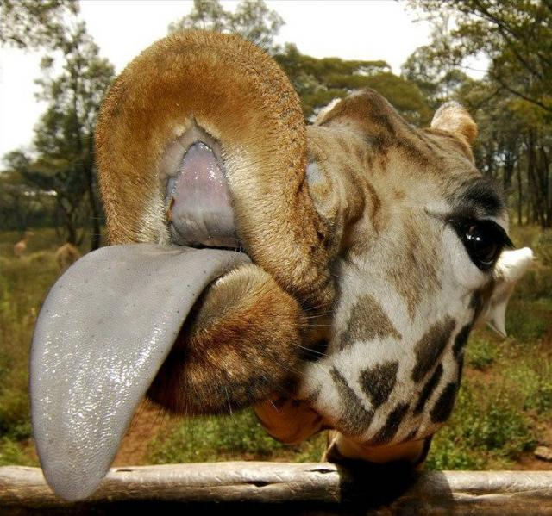
Example: object recognition
x
f(x)
giraffe
giraffe
giraffe
llama
llama
llama
X=
f(x)=?

Slide 28
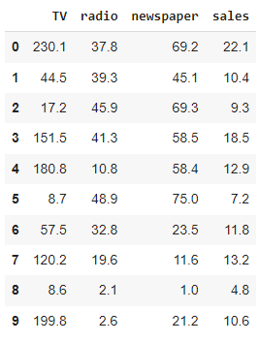
Supervised Learning
Given examples of a function (X, f(X))
Predict function f(X) for new examples X
Discrete f(X): Classification
Continuous f(X): Regression
F(X) = Probability(X ): Probability estimation
X
y

Slide 29
Linear Regression

Slide 30
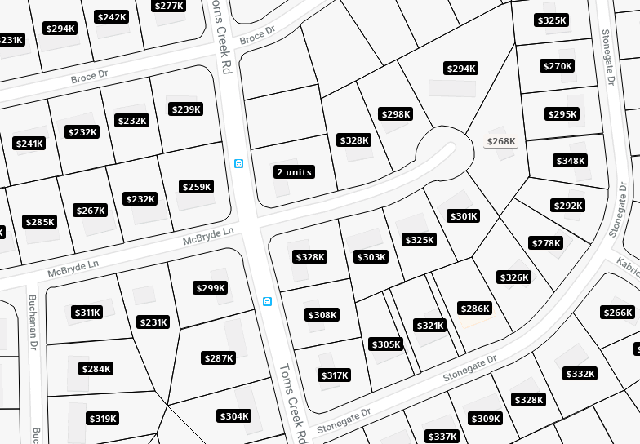
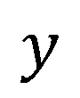
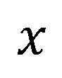
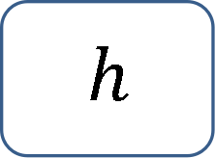
Regression
real-valued output
Training set
Learning Algorithm
$$h$$
$$x$$
$$y$$
Size of house
Hypothesis
Estimated price

Slide 31
House pricing prediction
Price ($) in 1000’s
400
300
200
100
500
1000
1500
2000
2500
Size in feet^2

Slide 32
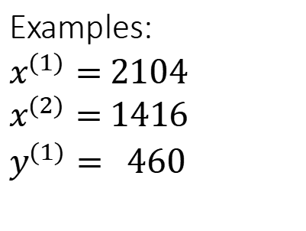
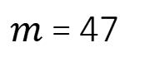
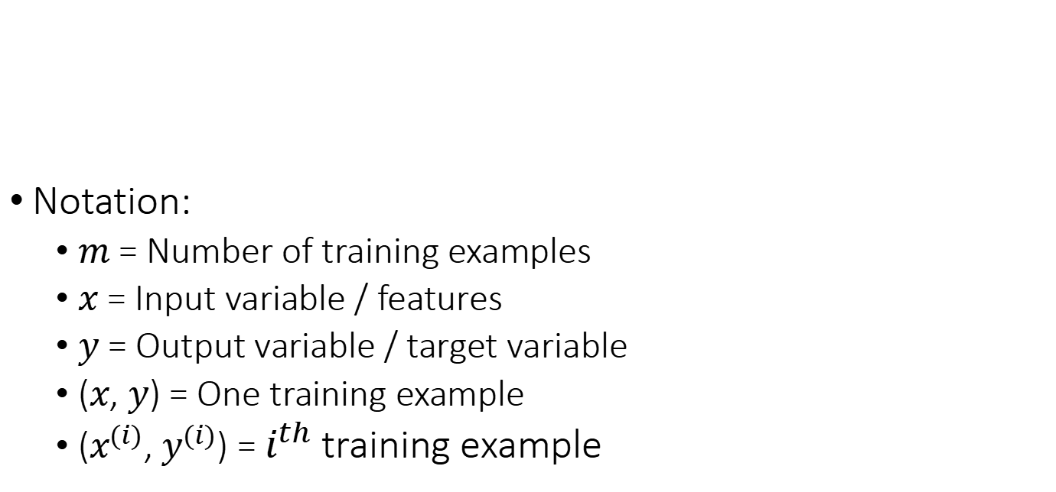
Training set
Size in feet^2 (x) | Price ($) in 1000’s (y)
2104 | 460
1416 | 232
1534 | 315
852 | 178
… | …
Notation:
$m$ = Number of training examples
$x$ = Input variable / features
$y$ = Output variable / target variable
($x$, $y$) = One training example
($x^{(i)}$, $y^{(i)}$) = $i^{th}$training example
$m$ = 47
Examples:
$x^{(1)}=$ $2104$
$x^{(2)}=$ $1416$
$y^{(1)}=$ $460$

Slide 33
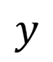
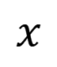
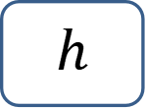
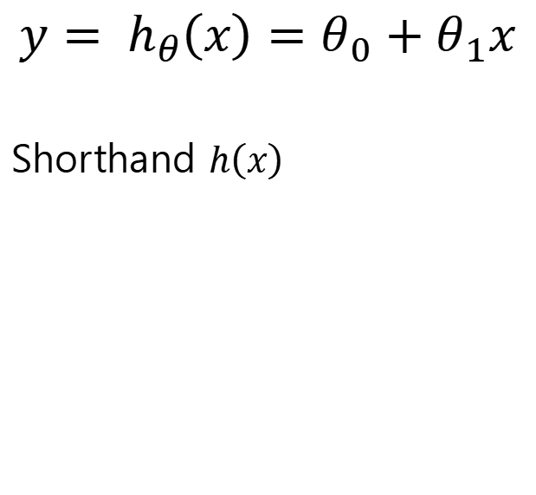
Model representation
$$y= h_{θ}\left(x\right)=θ_{0}+θ_{1}x$$
Shorthand $h\left(x\right)$
Training set
Learning Algorithm
Price ($) in 1000’s
400
300
$$x$$
$$h$$
$$y$$
200
100
Size of house
Hypothesis
Estimated price
500
1000
1500
2000
2500
Size in feet^2
Univariate linear regression

Slide 34
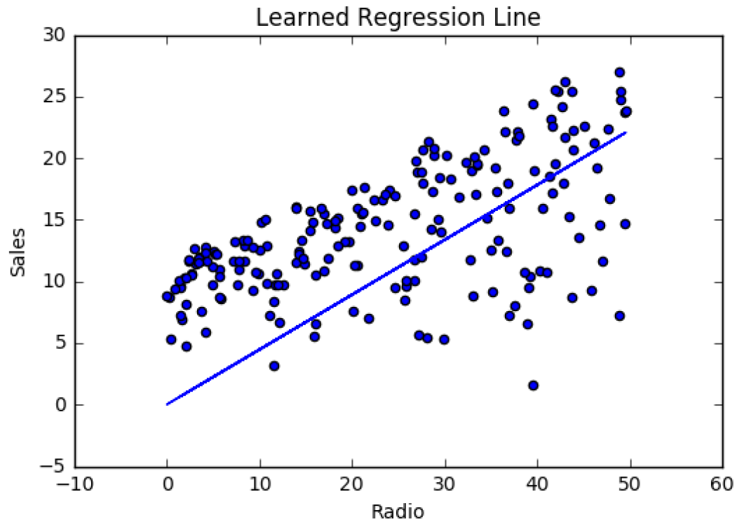
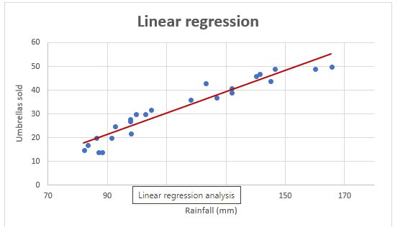
Linear Regression
Linear Regression is a supervised machine learning algorithm where the predicted output is continuous and has a constant slope.

Slide 35
Linear Regression
There are two main types:
Simple regression (Linear regression with one variable)
Multivariable regression

Slide 36
Simple Regression (Linear regression with one variable)

Slide 37
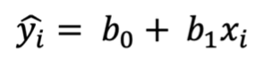
Simple Regression
Only one independent variable, X
Relationship between X and Y is described by a linear function
Changes in Y are assumed to be related to changes in X

Slide 38
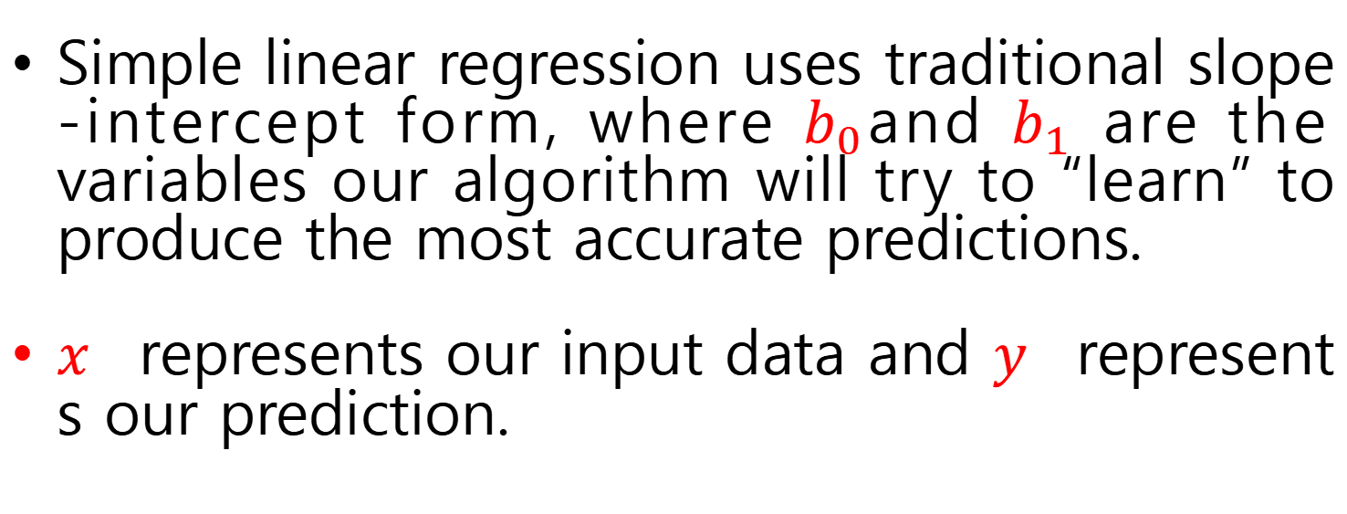
Simple Regression
Simple linear regression uses traditional slope-intercept form, where $b_{0}$and $b_{1}$ are the variables our algorithm will try to “learn” to produce the most accurate predictions.
𝑥 represents our input data and 𝑦 represents our prediction.

Slide 39
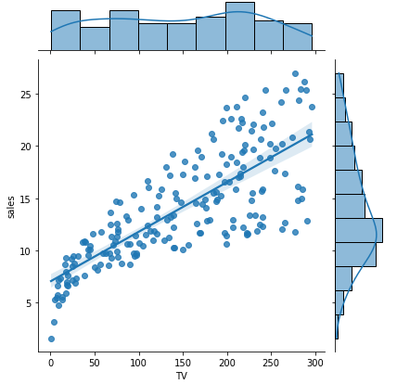
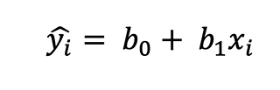
Simple Regression

Slide 40
Simple Regression
Population Slope Coefficient
Population Y intercept
Independent Variable
Random Error term
Dependent Variable
Linear component
Random Error
component

Slide 41
Simple Regression
Y
ε_{i}
Slope = β₁
Predicted Value of Y for X_{i}
Random Error for this X_{i} value
Intercept = β₀
X_{i}

Slide 42
Simple Regression
The simple linear regression equation provides an estimate of the population regression line
Estimate of the regression intercept
Estimated (or predicted) Y value for observation i
Estimate of the regression slope
Value of X for observation i

Slide 43

Simple Regression
House price model: Scatter Plot and Prediction Line
House Price in $1000s (y) | Square Feet (x)
245 | 1400
312 | 1600
279 | 1700
308 | 1875
199 | 1100
219 | 1550
405 | 2350
324 | 2450
319 | 1425
255 | 1700
Slope
= 0.10977
Intercept
= 98.248

Slide 44
Simple Regression
b₀ is the estimated mean value of Y when the value of X is zero (if X = 0 is in the range of observed X values)
Because a house cannot have a square footage of 0, b₀ has no practical application

Slide 45
Simple Regression
b₁ estimates the change in the mean value of Y as a result of a one-unit increase in X
Here, b₁ = 0.10977 tells us that the mean value of a house increases by .10977($1000) = $109.77, on average, for each additional one square foot of size

Slide 46
Example
Predict the price for a house with 2000 square feet:
The predicted price for a house with 2000 square feet is 317.85($1,000s) = $317,850

Slide 47
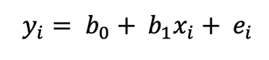
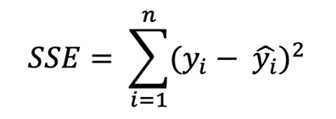
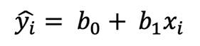
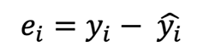
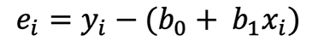
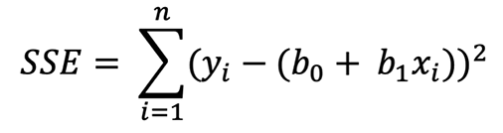
Performance Metrics for Regression

Slide 48
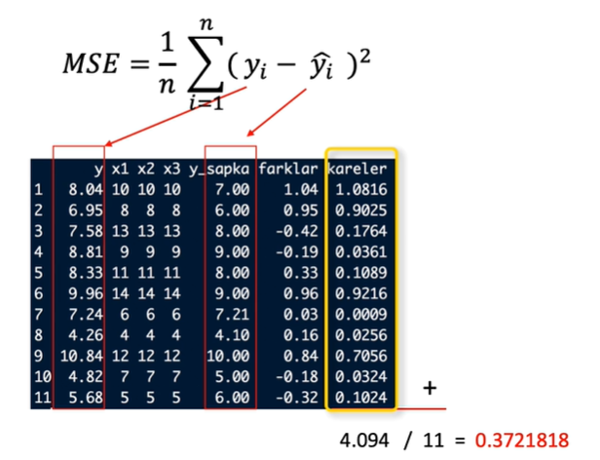
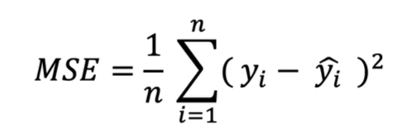
Performance Metrics for Regression

Slide 49
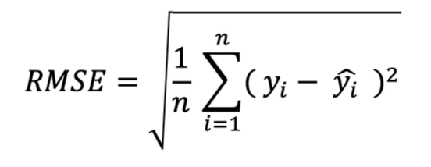
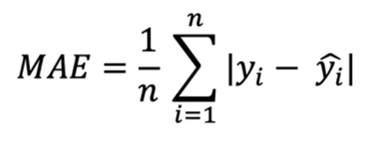
Performance Metrics for Regression

Slide 50
Performance Metrics for Regression

Slide 51
Simple Regression Cost Function
A Cost Function is used to measure just how wrong the model is in finding a relation between the input and output.
It tells you how badly your model is behaving/predicting

Slide 52

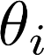
Simple Regression Cost Function
Size in feet² (x) | Price ($) in 1000's (y)
2104 | 460
1416 | 232
1534 | 315
852 | 178
… | …
Hypothesis:
‘s: Parameters
How to choose ‘s ?

Slide 53
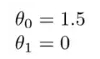

Simple Regression Cost Function
Hypothesis:
The theta values are the parameters.
Some quick examples of how we visualize the hypothesis:
This yields h(x) = 1.5 + 0x. 0x means no slope, and y will always be the constant 1.5
This looks like:

Slide 54


Simple Regression Cost Function
Hypothesis:
The theta values are the parameters.
Some quick examples of how we visualize the hypothesis:
This yields h(x) = 1 + 0.5x
This looks like:

Slide 55





$$h_{θ}\left(x\right)=θ_{0}+θ_{1}x$$
$$y$$
$$y$$
$$y$$
3
3
3
2
2
2
1
1
1
1
2
3
$$x$$
1
2
3
$$x$$
1
2
3
$$x$$
$$θ_{0}=1.5$$
$$θ_{1}=0$$
$$θ_{0}=0$$
$$θ_{1}=0.5$$
$θ_{0}=1$
$$θ_{1}=0.5$$

Slide 56




Simple Regression Cost Function
y
x
Idea: Choose so that is close to for our training examples

Slide 57


Simple Regression Cost Function
Hypothesis:
Parameters:
Cost Function:
Goal:

Slide 58





(for fixed , this is a function of x)
(function of the parameter )
y
x
Find Cost Function.

Slide 59



(for fixed , this is a function of x)
(function of the parameter )
y
x

Slide 60




(for fixed , this is a function of x)
(function of the parameters )
Price ($)
in 1000’s
Size in feet² (x)

Slide 61




$h_{θ}\left(x\right)$, function of $x$
$J\left(θ_{1}\right)$, function of $θ_{1}$
$$y$$
$$J\left(θ_{1}\right)$$
3
3
2
2
1
1
$$x$$
$$θ_{1}$$
1
2
3
0
1
2
3

Slide 62
$h_{θ}\left(x\right)$, function of $x$
$J\left(θ_{1}\right)$, function of $θ_{1}$
$$y$$
$$J\left(θ_{1}\right)$$
3
3
2
2
1
1
$$x$$
$$θ_{1}$$
1
2
3
0
1
2
3

Slide 63
$h_{θ}\left(x\right)$, function of $x$
$J\left(θ_{1}\right)$, function of $θ_{1}$
$$y$$
$$J\left(θ_{1}\right)$$
3
3
2
2
1
1
$$x$$
$$θ_{1}$$
1
2
3
0
1
2
3

Slide 64
$h_{θ}\left(x\right)$, function of $x$
$J\left(θ_{1}\right)$, function of $θ_{1}$
$$y$$
$$J\left(θ_{1}\right)$$
3
3
2
2
1
1
$$x$$
$$θ_{1}$$
1
2
3
0
1
2
3

Slide 65
$h_{θ}\left(x\right)$, function of $x$
$J\left(θ_{1}\right)$, function of $θ_{1}$
$$y$$
$$J\left(θ_{1}\right)$$
3
3
2
2
1
1
$$x$$
$$θ_{1}$$
1
2
3
0
1
2
3

Slide 66

Contour Plot of Cost Function

Slide 67

Gradient Descent
Have some function
Want
Outline:
Start with some
Keep changing to reduce until we hopefully end up at a minimum

Slide 68

J(θ₀,θ₁)
θ₁
θ₀

Slide 69
J(θ₀,θ₁)
θ₁
θ₀

Slide 70



Gradient descent algorithm
Simultaneous update

Slide 71


Gradient Descent
Gradient descent is an efficient optimization algorithm that attempts to find a local or global minimum of the cost function. We’re going to be using gradient descent to find THETA that minimizes the cost

Slide 72



Gradient Descent

Slide 73


$$θ_{1} ≔θ_{1}−α \frac{∂}{∂θ_{1}}J\left(θ_{1}\right)$$
$$J\left(θ_{1}\right)$$
$$\frac{∂}{∂θ_{1}}J\left(θ_{1}\right)<0$$
3
$$\frac{∂}{∂θ_{1}}J\left(θ_{1}\right)>0$$
2
1
$$θ_{1}$$
0
1
2
3

Slide 74

Gradient Descent

Slide 75


Gradient Descent
If α is too small, gradient descent can be slow.
If α is too large, gradient descent can overshoot the minimum. It may fail to converge, or even diverge.

Slide 76

Learning rate

Slide 77


Gradient Descent
at local optima
Current value of

Slide 78



(for fixed , this is a function of x)
(function of the parameters )

Slide 79


(for fixed , this is a function of x)
(function of the parameters )

Slide 80


(for fixed , this is a function of x)
(function of the parameters )

Slide 81


(for fixed , this is a function of x)
(function of the parameters )

Slide 82


(for fixed , this is a function of x)
(function of the parameters )

Slide 83


(for fixed , this is a function of x)
(function of the parameters )

Slide 84


(for fixed , this is a function of x)
(function of the parameters )

Slide 85


(for fixed , this is a function of x)
(function of the parameters )

Slide 86



(for fixed , this is a function of x)
(function of the parameters )

Slide 87
Multiple Linear Regression (Linear Regression with multiple variables)

Slide 88


Multiple Linear Regression

Slide 89







Multiple Linear Regression
Size (feet²) | Number of bedrooms | Number of floors | Age of home (years) | Price ($1000)
2104 | 5 | 1 | 45 | 460
1416 | 3 | 2 | 40 | 232
1534 | 3 | 2 | 30 | 315
852 | 2 | 1 | 36 | 178
… | … | … | … | …
$$X_{1}$$
$$X_{2}$$
$$X_{3}$$
$$X_{4}$$
Y
Notation:
= number of features
= input (features) of training example.
= value of feature in training example.
Notes:
Pop-up Quiz

Slide 90
Multivariate linear regression

Slide 91













New algorithm :
Gradient Descent
Repeat
Previously (n=1):
Repeat
(simultaneously update for
)
(simultaneously update )

Slide 92


Gradient descent for linear regression
Repeat until convergence{
$$θ_{0} ≔θ_{0}−α\frac{1}{m}\sum_{i=1}^{m}{\left(h_{θ}\left(x^{\left(i\right)}\right)−y^{\left(i\right)}\right)}$$
$$θ_{1} ≔θ_{1}−α\frac{1}{m}\sum_{i=1}^{m}{\left(h_{θ}\left(x^{\left(i\right)}\right)−y^{\left(i\right)}\right)}x^{\left(i\right)}$$
}
Update $θ_{0}$ and $θ_{1}$ simultaneously

Slide 93


Batch gradient descent
“Batch”: Each step of gradient descent uses all the training examples
Repeat until convergence{
$$θ_{0} ≔θ_{0}−α\frac{1}{m}\sum_{i=1}^{m}{\left(h_{θ}\left(x^{\left(i\right)}\right)−y^{\left(i\right)}\right)}$$
$$θ_{1} ≔θ_{1}−α\frac{1}{m}\sum_{i=1}^{m}{\left(h_{θ}\left(x^{\left(i\right)}\right)−y^{\left(i\right)}\right)}x^{\left(i\right)}$$
}
$m$: Number of training examples

Slide 94


Gradient descent in practice: Learning rate
Automatic convergence test
$α$ too small: slow convergence
$α$ too large: may not converge
To choose $α$, try
0.001, … 0.01, …, 0.1, … , 1

Slide 95
Polynomial Regression

Slide 96


Polynomial Regression
Notes:
Pop-up Quiz

Slide 97

Polynomial Regression
Notes:
Pop-up Quiz

Slide 98


House prices prediction
$h_{θ}\left(x\right)=θ_{0}+θ_{1}×frontage+θ_{2}×depth$
Area $$x= frontage×depth$$
$h_{θ}\left(x\right)=θ_{0}+θ_{1}x$

Slide 99


Polynomial regression
$h_{θ}\left(x\right)=θ_{0}+θ_{1}x_{1}+θ_{2}x_{2}+θ_{3}x_{3}$
$=θ_{0}+θ_{1}\left(size\right)+θ_{2}{\left(size\right)}^{2}+θ_{3}{\left(size\right)}^{3}$
Price ($) in 1000’s
400
300
200
$x_{1}$ = (size)
$x_{2}$ = (size)^2
$x_{3}$ = (size)^3
100
500
1000
1500
2000
2500
Size in feet^2

Slide 100







Polynomial regression
Price
(y)
Size (x)

Slide 101

Things to remember
Model representation
$$h_{θ}\left(x\right)=θ_{0}+θ_{1}x_{1}+θ_{2}x_{2}+…+θ_{n}x_{n}=θ^{⊤}x$$
Cost function $J\left(θ\right)=\frac{1}{2m}\sum_{i=1}^{m}{{\left(h_{θ}\left(x^{\left(i\right)}\right)−y^{\left(i\right)}\right)}^{2}}$
Gradient descent for linear regression Repeat until convergence {$θ_{j} ≔θ_{j}−α\frac{1}{m}\sum_{i=1}^{m}{\left(h_{θ}\left(x^{\left(i\right)}\right)−y^{\left(i\right)}\right)}x_{j}^{\left(i\right)}$}
Features and polynomial regression
Can combine features; can use different functions to generate features (e.g., polynomial)
Normal equation $θ={(X^{⊤}X)}^{−1}X^{⊤}y$

